Slide 1
Intel Unnati Training Project
Palak Machhi

Slide 2
Problem Statement
Running GenAI on Intel AI Laptops and Simple LLM Inference on CPU and fine-tuning of LLM Models using Intel® OpenVINO™

Slide 3
Unique Idea Brief (Solution)
I have created book-recommendation chat-bot and fine-tune it.
Here chat-bot is trained by combine dataset which is build using book dataset, user's dataset and rating dataset.
Here chat-bot will recommend users, book based on their past-search and which has high ratings.

Slide 4
Features Offered
Interactive Chat-bot with user friendly UI.
Also learn from user's data.
Recommendation based on past-search and high rating.

Slide 5
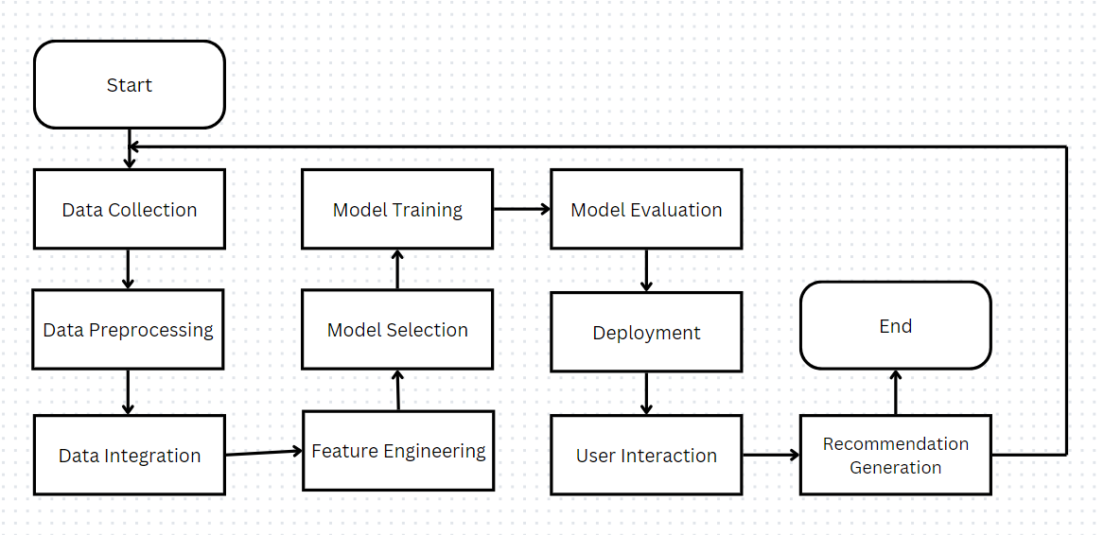
Process Flow

Slide 6
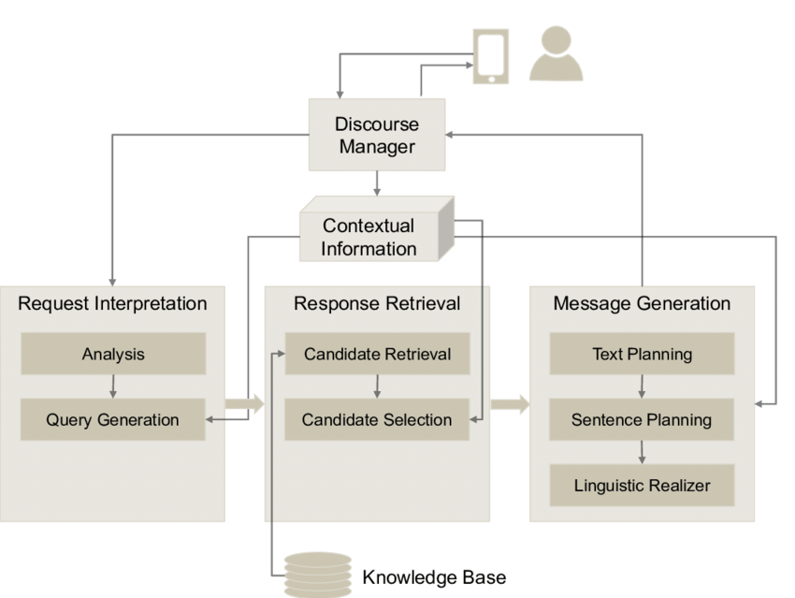
Architecture Diagram

Slide 7

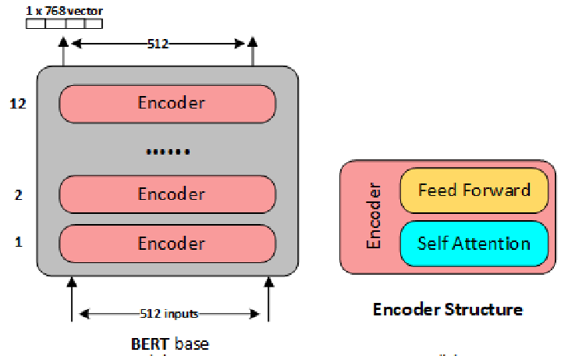
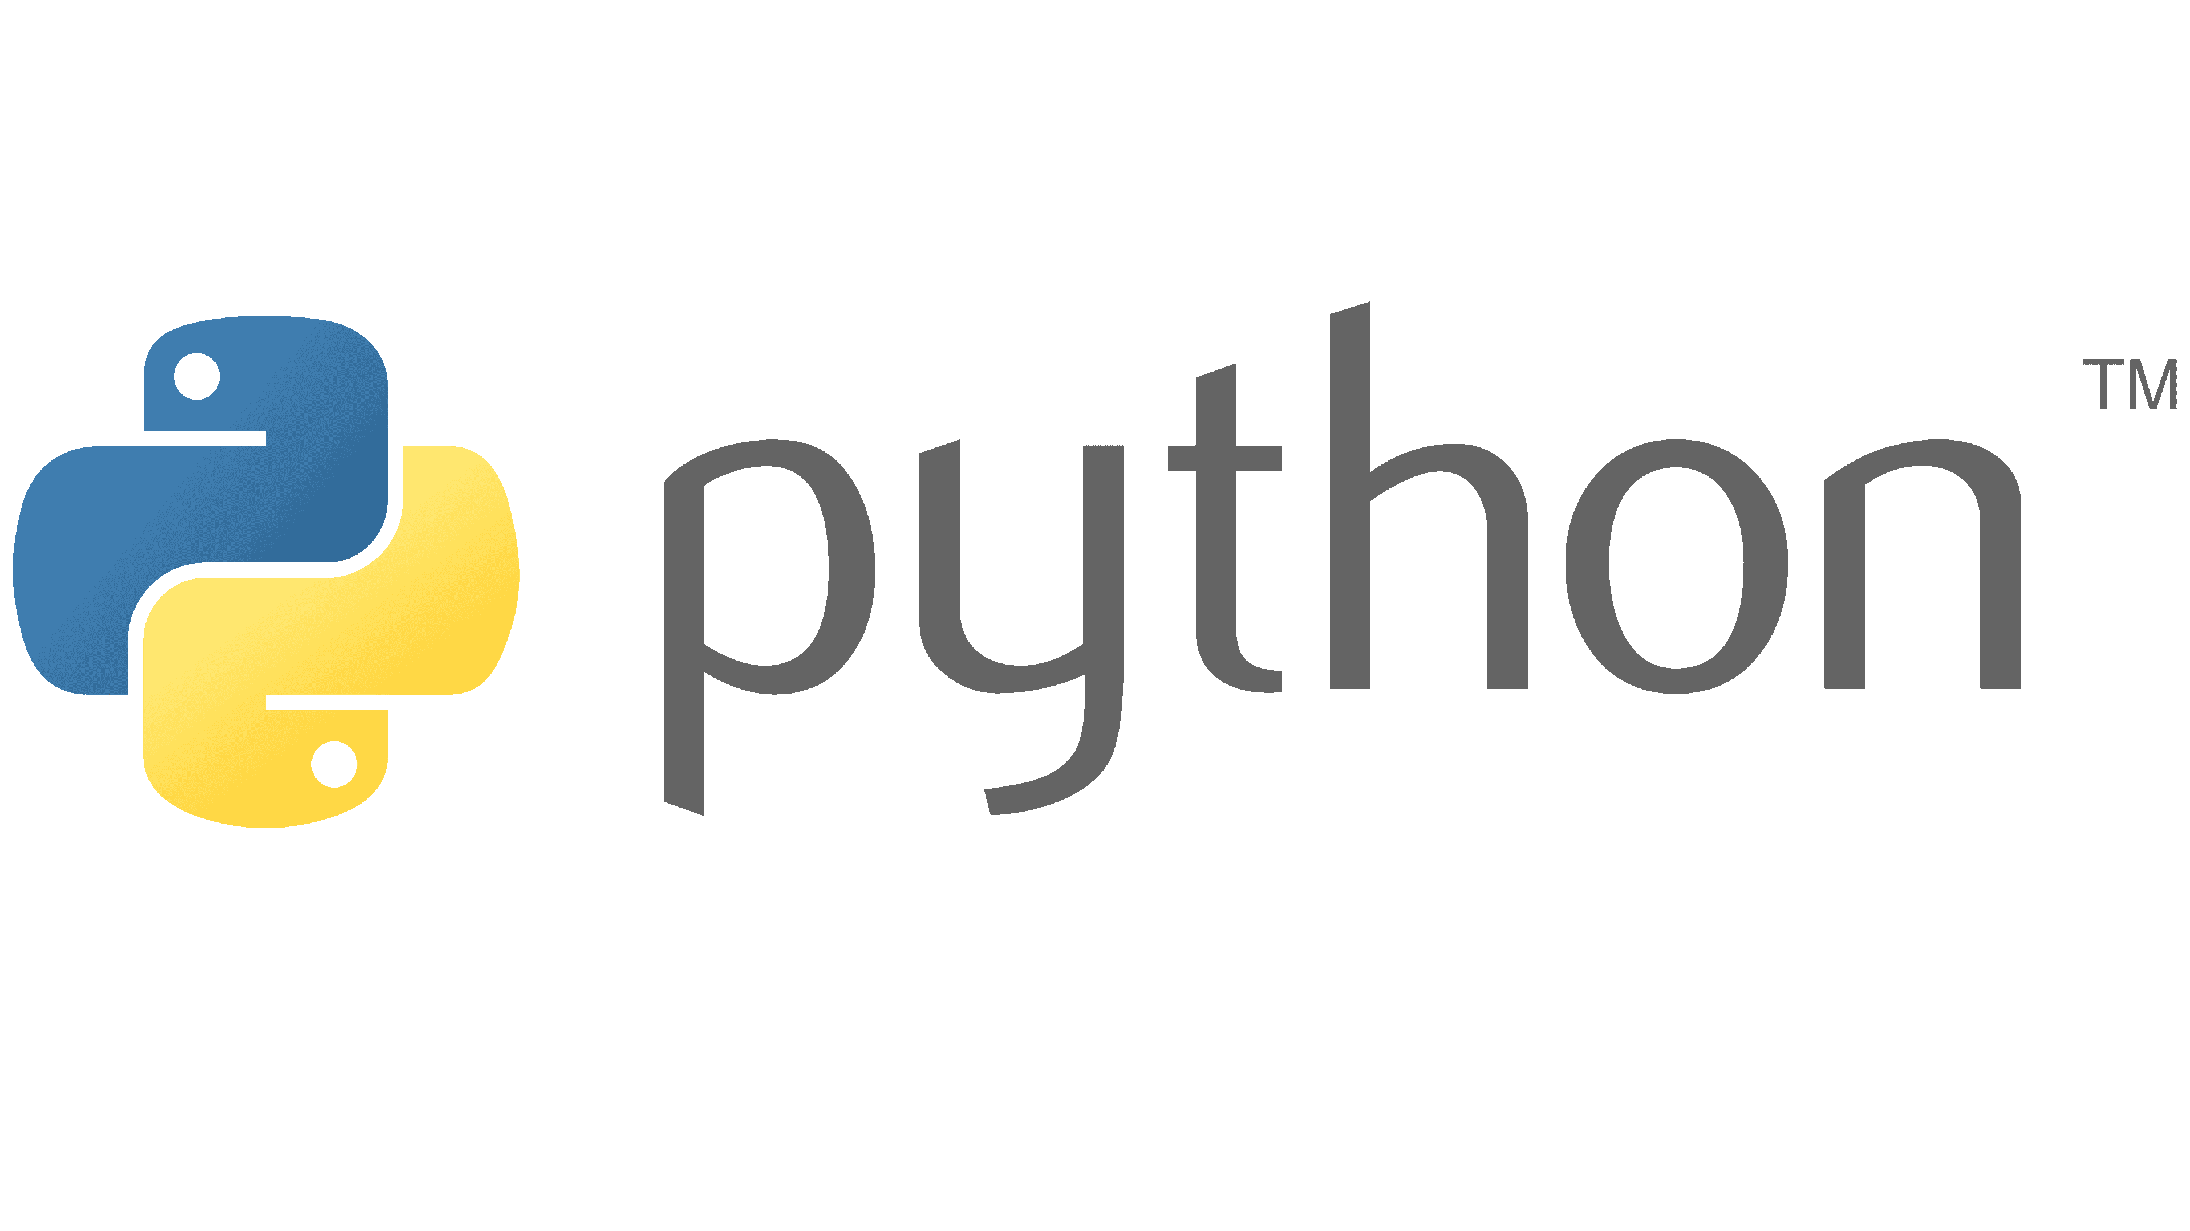
Technology Used

Slide 8
Team Member and Contribution
Palak Dilipbhai Machhi
All document the project by outlining setup, LLM inference on CPU, fine-tuning with Intel OpenVINO, and creating a custom book recommendation chatbot, culminating in a detailed report covering problem statement, technical approach, results, and future recommendations.

Slide 9
Conclusion
Outcomes and insights, emphasizing the foundational understanding gained in Generative AI, practical skills in LLM inference on CPU, proficiency in fine-tuning LLMs with Intel OpenVINO, and the creation of a custom Chatbot.

